Slide 1
E-mechanic

Slide 2

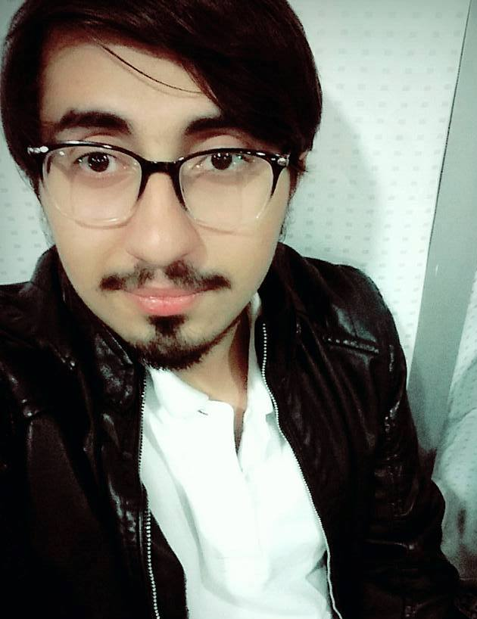
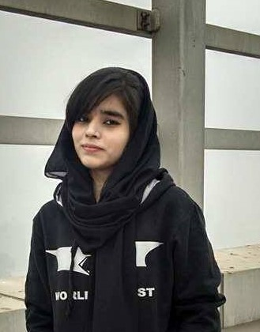

Team members
Usama Latif
BSCS13001
Zain Amjad
BSCS13041
Tayeba Tariq
BSCS13058
Muqaddas Rashid
BSCS13070

Slide 3

Solving problem of bike maintenance due to time shortage

Slide 4
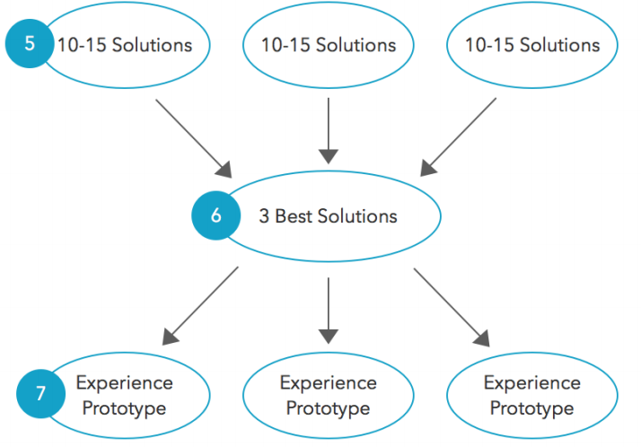
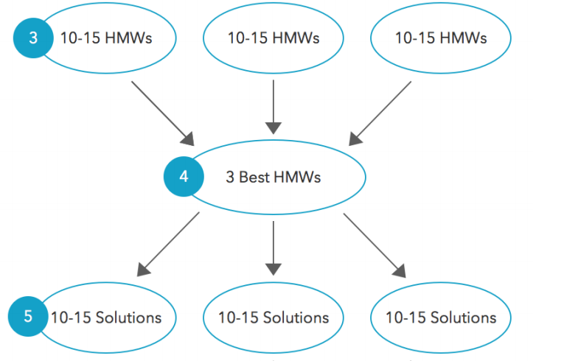
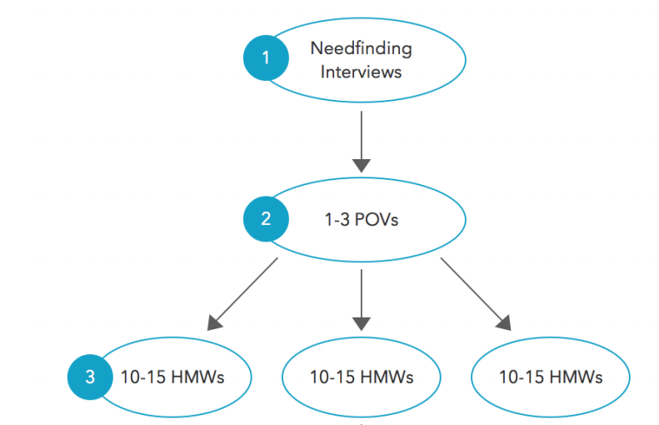
Process & methodology

Slide 5

1- Needfinding interviews

Slide 6
1- additional interviews
Survey was conducted on 5 more interviewers
Our spectrum included:
Class B and class C bike riders
Aged people as well as youngsters
Questionnaire included open ended questions to find ground reality
Questions were asked in form of a conversation to gain trust

Slide 7
2 – Point of views (POVs)

Slide 8
Pov # 1
We met: an average worker who has to work from morning till evening and only has to travel on his bike from his home to office and office to home.
We were amazed: that apparently he don’t had any issue with his bike maintenance but he was status quo and had a fixed mechanic. Only he had time issue, if his mechanic not free then he waited for him.
It would be game changing: we could create comfortable time slot for him for his bike maintenance.

Slide 9
POV # 2
We met: : a well-travelled and very young office worker whose job was not too tough and lived in central Lahore but has to ride his bike for about 40 Kilometers per day.
We were amazed: to know that he also wanted a service which could provide him ease and he comfortably gets his bike maintained because he too had shortage of time and couldn’t take his bike for maintenance to mechanic and he highlighted charges issue as well.
It would be game changing if: we could come up with a service that meets these challenges and provide him that service.

Slide 10
POV # 3
We met: : a middle aged man who runs his own textile business and administrate his subordinates and has to a lot of meetings for his business and also has to projects deals either on his own business place or has to move from one corner of city to another.
We were amazed: to see that he liked our idea because he has a lot of issues regarding bike maintenance. For example; time shortage etc.
It would be game changing if: firstly, if we are able to accomplish all these challenges highlighted by him. Secondly, if we could make our service comfortable enough for him during his busy routine life.

Slide 11
3 – How might we? (hmw)

Slide 12
Hmw # 1
People are status Quo, they have their fixed mechanics
HMW?: We change their mindset so that we may convince them to use our service.

Slide 13
Hmw # 2
People can’t afford extra charges but only 30 or less than 50 rupees per service
HMW?: Create costs effective method for charging them which meet their cost requirements.

Slide 14
Hmw # 3
If we come up with a bike maintenance service and make our service comfortable enough for people during their busy routine life.
HMW?: We come up with a service that meet different challenges highlighted by people.

Slide 15
4- solution

Slide 16
Solution # 1
HMW?: We change their mindset so that we may convince them to use our service
We’ll provide all the services as We’ll provide all the services as they require because outside mechanics do work of their own choice.

Slide 17
Solution # 2
HMW?: Create costs effective method for charging them which meet their cost requirements
We can offer them vouchers so that they may get discount.

Slide 18
Solution # 3
HMW?: We come up with a service that meet different challenges highlighted by people
Most of the people had time issue for their bike maintenance, we’ll maintain their bike in the time they require or they want.

Slide 19
5- experience prototype

Slide 20

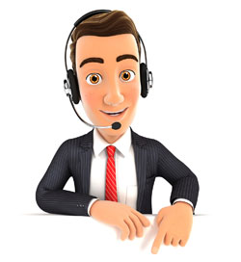
Prototype # 1 – Make a call
1- Customer will make a call
2- Greetings
3- we’ll ask him options then he’ll ans.
4- We’ll then enquire him about any other issue and them we’ll tell him charges
5- we’ll ask him his address
6- Finally, we’ll send our mechanic to him.

Slide 21

Pr0t0type # 2 – vouchers/discount
1- Customer will make a call
2- Greetings
3- we’ll ask him options then he’ll ans.
4- We’ll then enquire him about any other issue and them we’ll tell him charges
5- We’ll ask him about discount and promotions if he has any of them.
6- we’ll ask him his address and will tell him final charges.
7- Finally, we’ll send our mechanic to him.

Slide 22
Pr0t0type # 3 – online portal

Slide 23
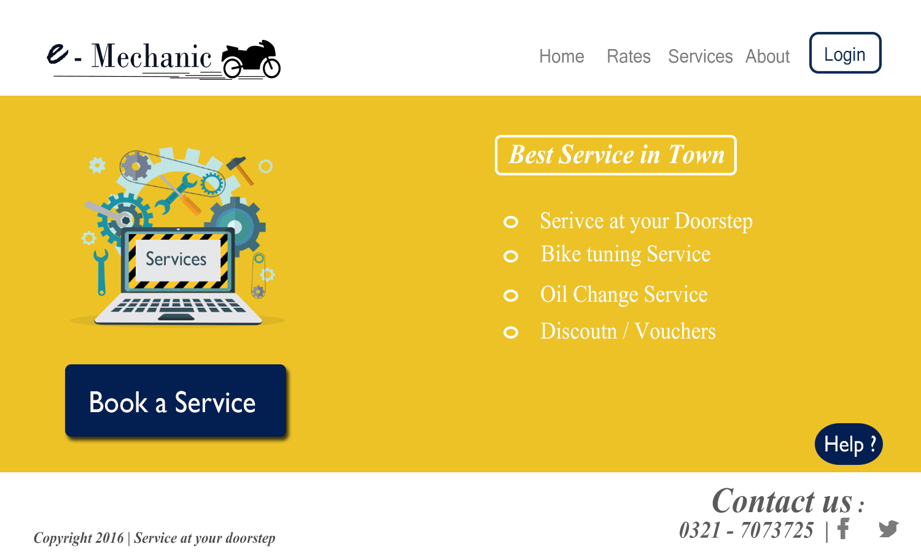

Slide 24
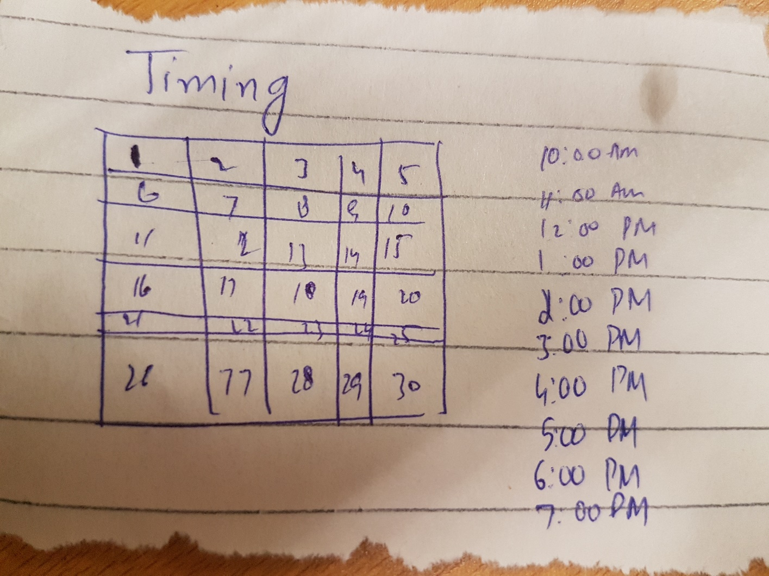
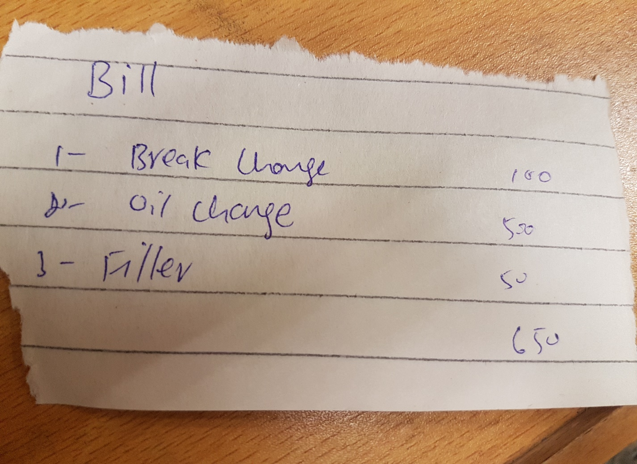
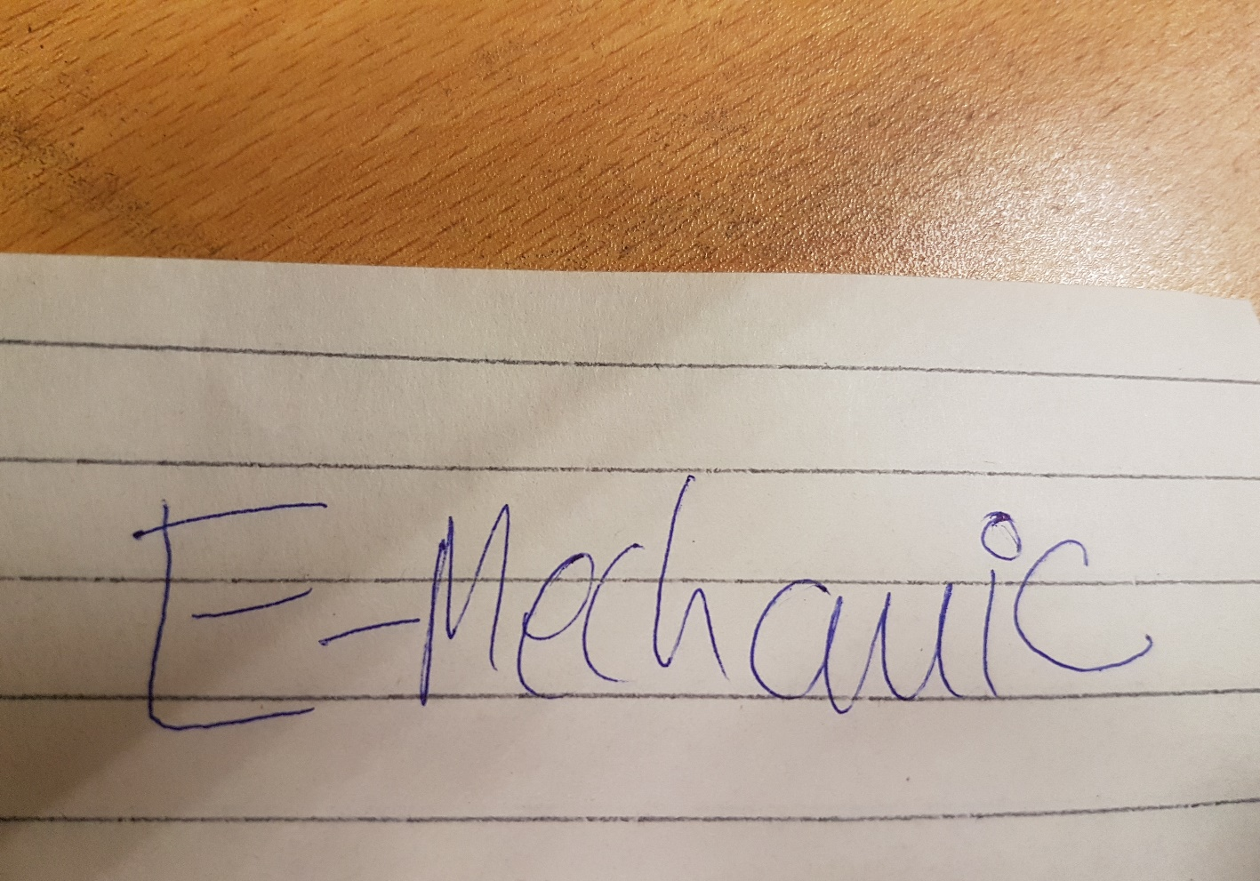
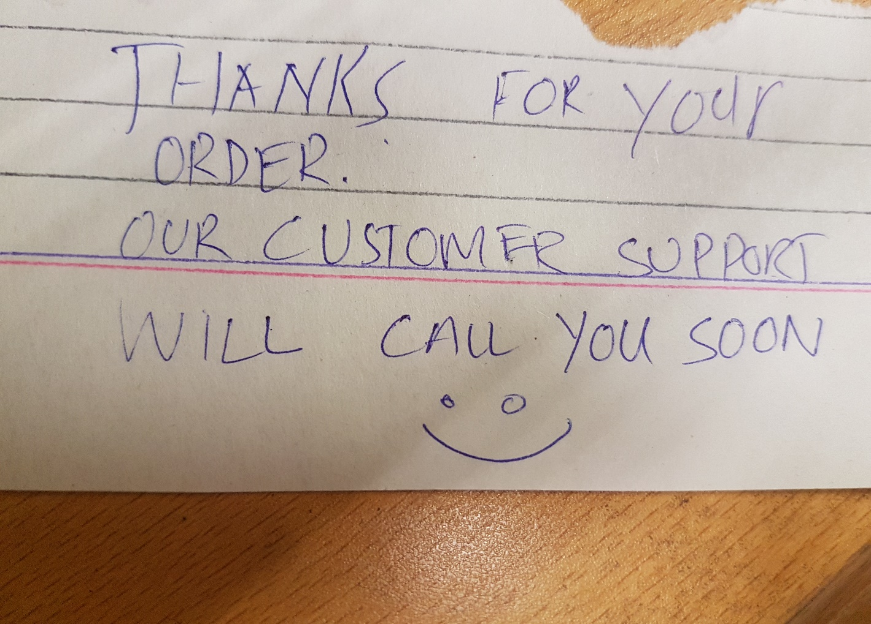
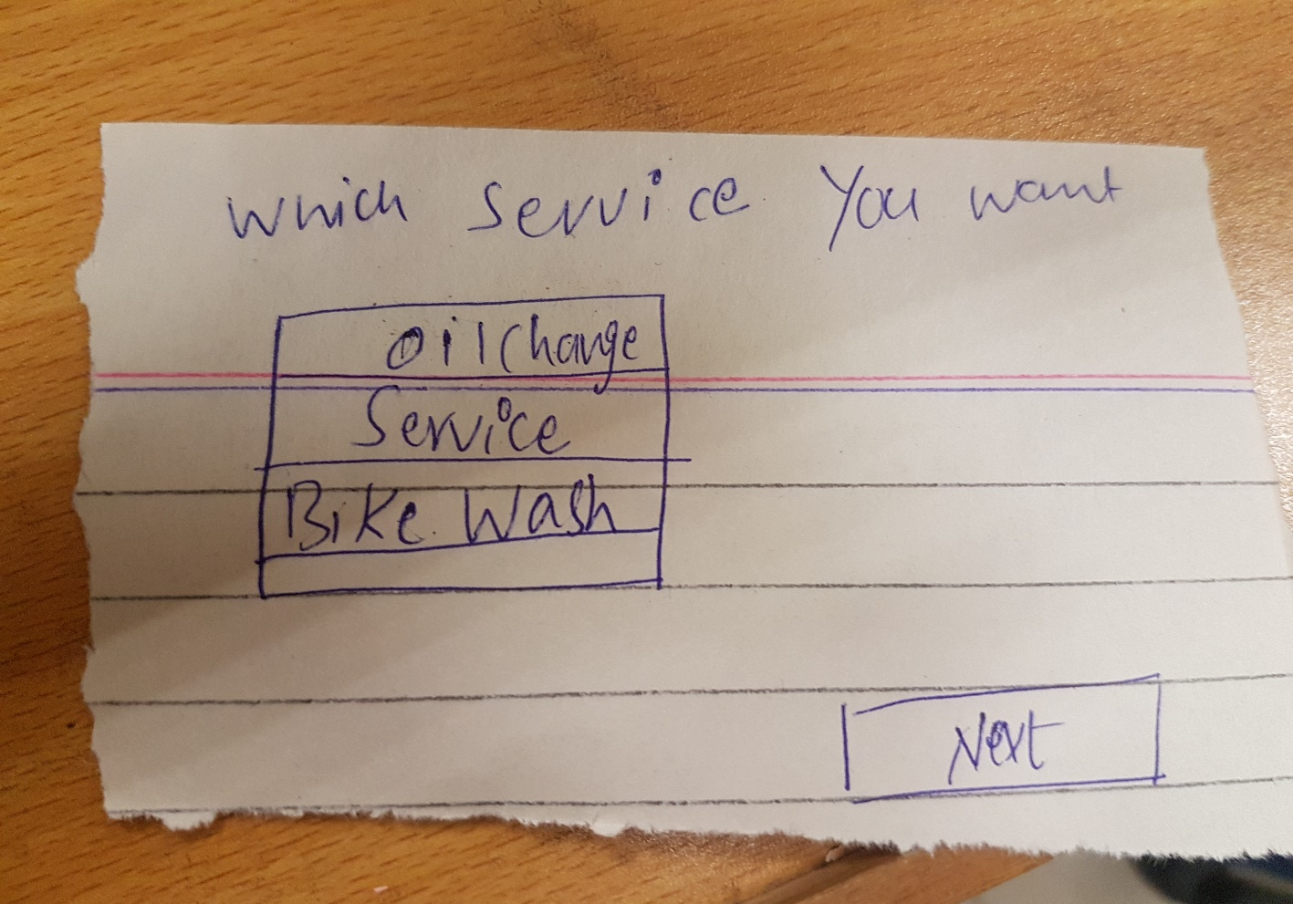
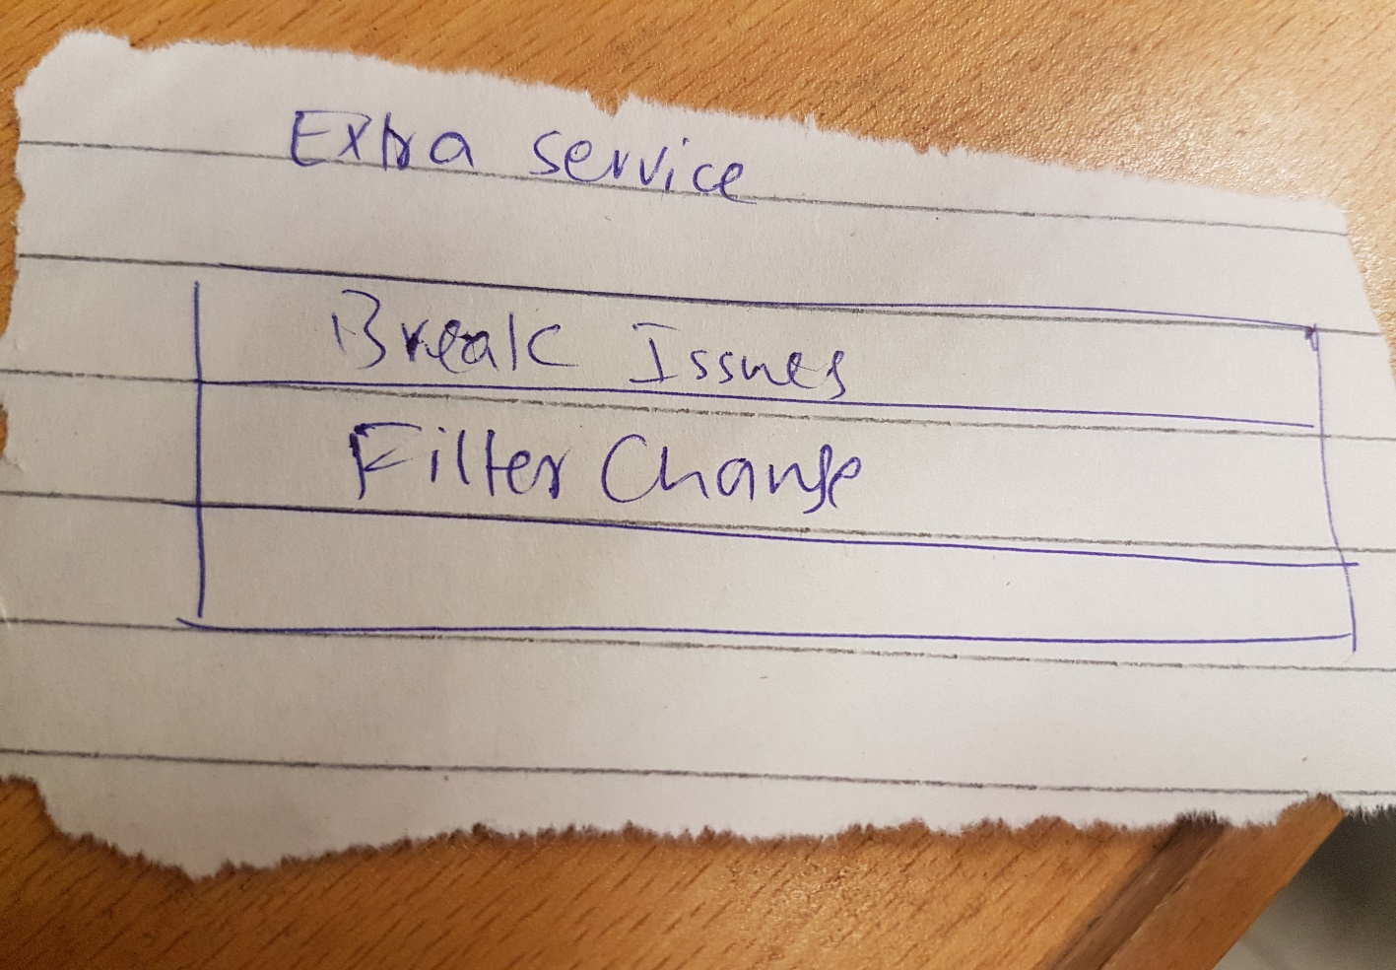


Book a service

Slide 25
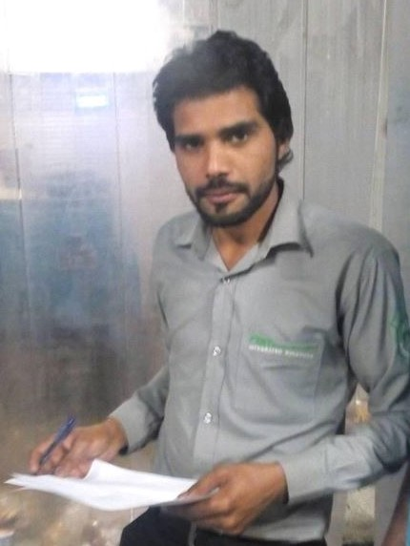
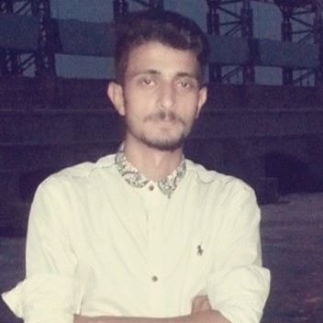
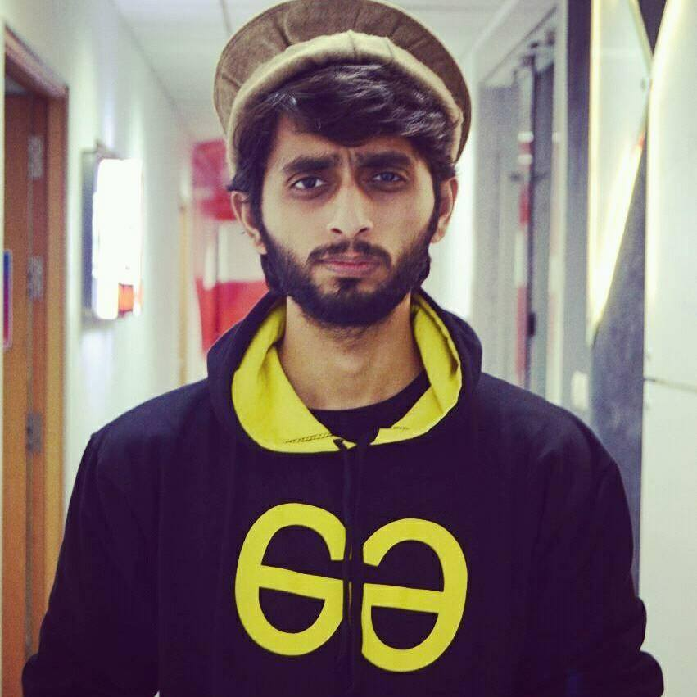
Pr0t0type’s Experiencers

Slide 26
conclusion

Slide 27
Questions?

